Slide 1
Reproducible Analytical Pipelines (RAP)
Joshua Halls and Catrin Cheung

Slide 2
What is an analytical pipeline?
The process of producing a final report or analytical publication
Get
Analyse
Visualise
Report
Quality Assurance
Notes:
1, The Get stage refers to getting the data from data sources.
2, Analyse – tidy data, manipulating data, building models
3. Visualise
4. Bring everything together with commentary in a report
5. Manual quality assurance to ensure each stage of the pipeline has been performed accurately

Slide 3
Production line risks
Processes are manual, hard to follow and error-prone
Source data and the output are not connected at all
Manual QA at each step - tedious and not full-proof
Desk notes – manual handing over

Slide 4
How can RAP provide a solution?
Streamline process from beginning to end
Ensure process is reproducible by self/others in future – packaging code, documentation
Version control, transparency and peer-review of code – Git, GitHub, GitLab
QA - data validation checks, unit tests to future proof, integrated unit tests

Slide 5

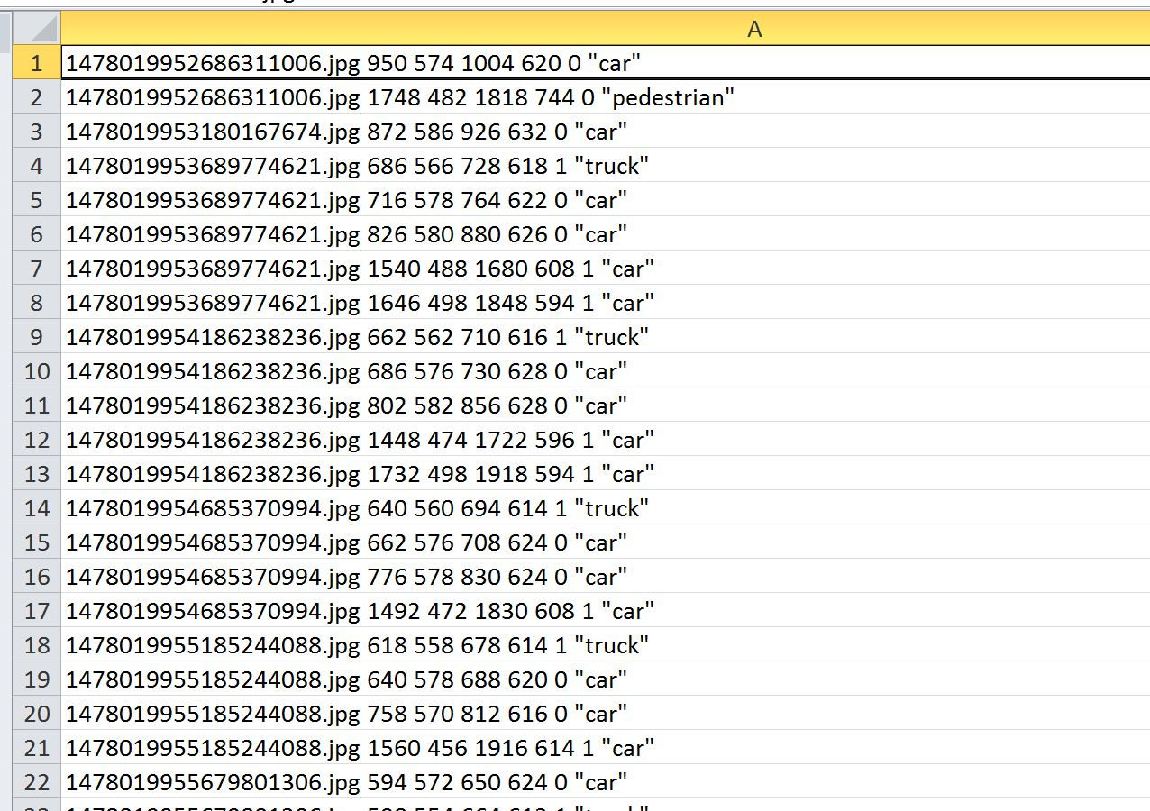




Notes:
Reports take:
a long time to produce
a long time to QA
a long time to reproduce

Slide 6




MonthlyReport package
Get
Visualise
Report
Analyse
R Markdown
csv files
Output
Data products
Local database
Git
GitHub
Travis CI
Codecov

Slide 7
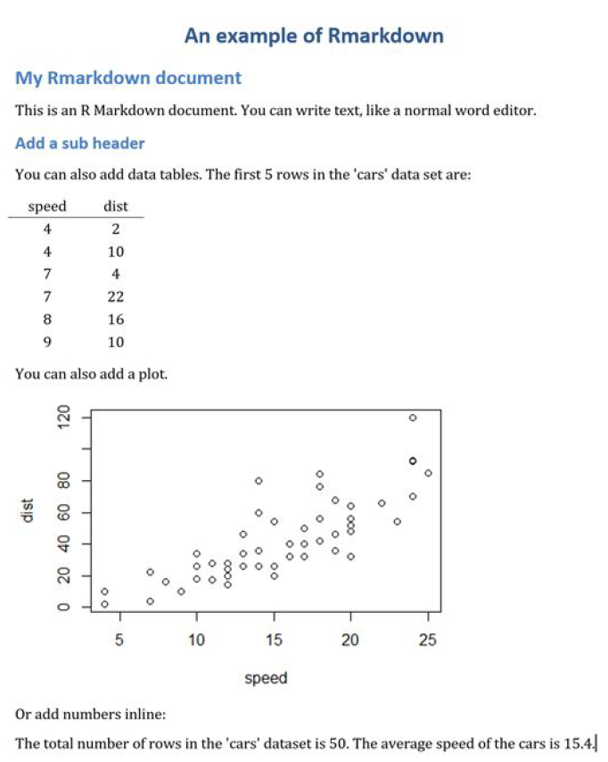
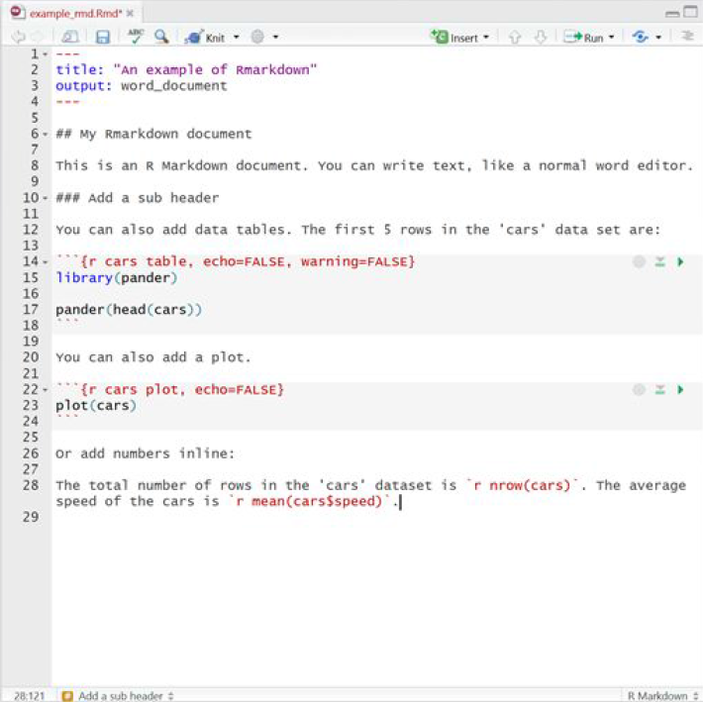
Markdown example

Slide 8
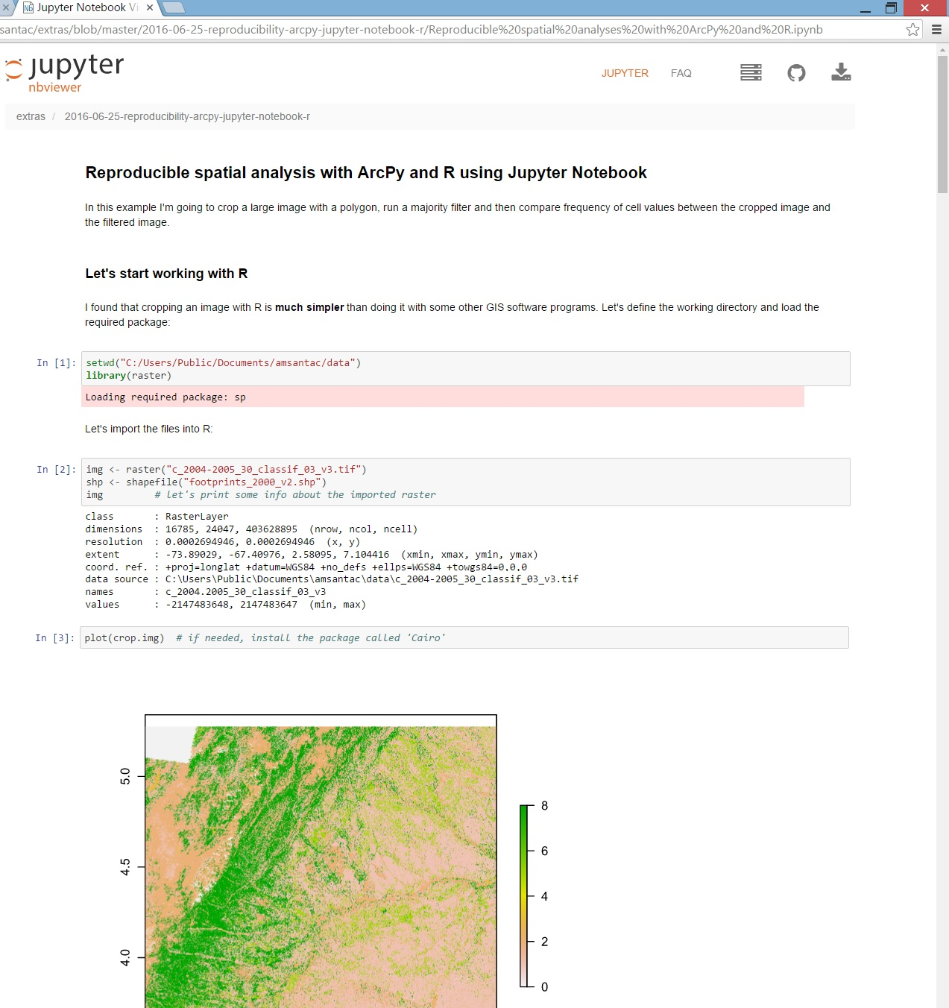
Jupyter example
Notes:
Jupyter notebook embedding python code.

Slide 9
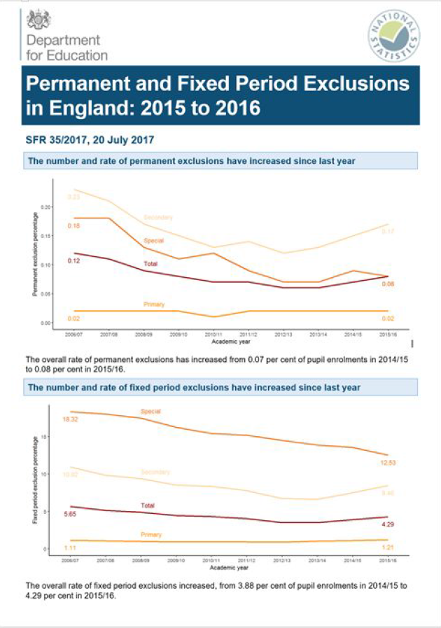
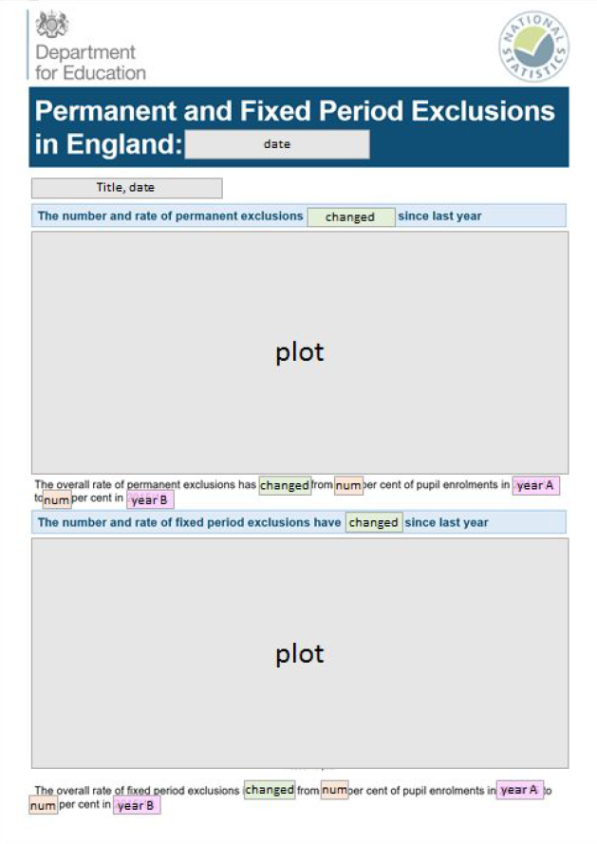

Slide 10
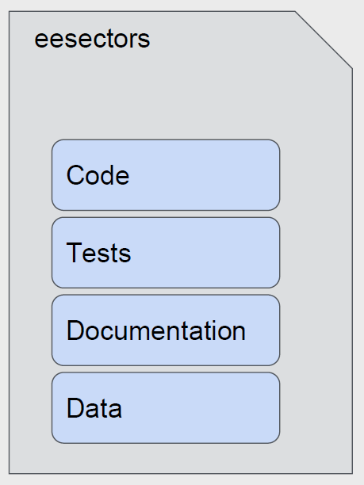
Everything is in one place
There is a full audit trail
This helps with institutional knowledge management

Slide 11
RAP in government
Government Digital Service RAP
GSS RAP Good Practice team
GSS RAP champions network
Other leading depts – DCMS, DfE, DfT, NHS Scotland
Most RAP has been in R so far

Slide 12
Government Digital Service RAP resources
RAP Companion (2018), Gregory, M., Upson, M.
Reproducible Analytical Pipelines (RAP) using R Massive Open Online Course, Udemy
https://ukgovdatascience.github.io/rap-website/index.html

Slide 13
RAP in ONS
Initial exploration in various business areas
BPI pilot with Health and Life Events Team (HALE) – divorces publication
DAP CATS framework and online resources

Slide 14
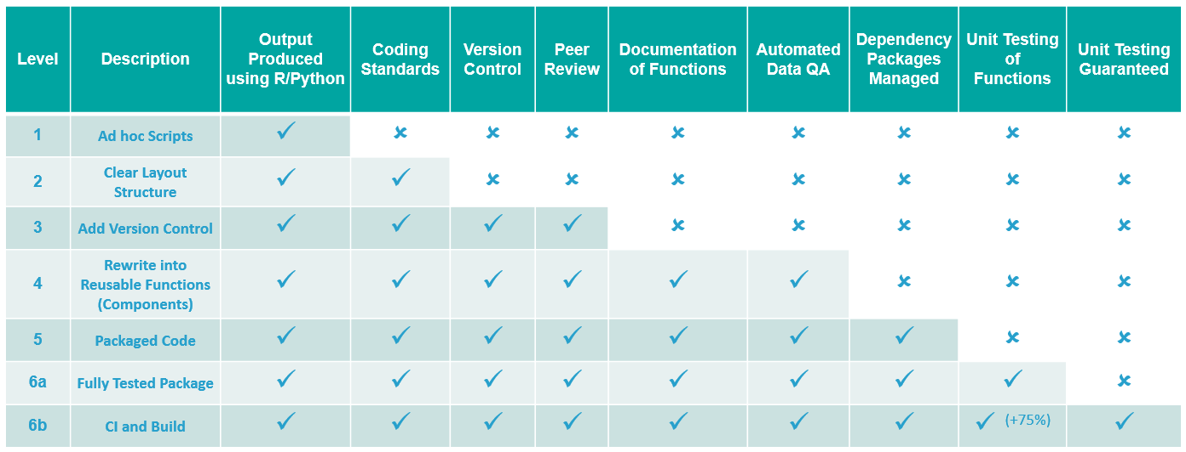

Slide 15
When to think about using RAP
You are repeating a workflow more than twice
Your workflow is time consuming and hard to replicate without a lot of manual intervention
The process is stable – the data sources, processes and outputs are broadly similar each time (although the data content might change)
The output doesn’t have to be a statistical report. It could be a standard set of statistics or graphs, a suite of data tables or a standard set of analyses and their outputs

Slide 16
When RAP can be hard
Data formats change frequently and unexpectedly
Publication format changes frequently
Limited access to open source tools. R, Rstudio, Rtools, Python, Git, GitHub
Takes time to get to grips with techniques and tools – analysts need time to learn and deploy RAP

Slide 17
Challenges ahead
Upskilling
Access to tools on ONS machines
Security
RAP in DAP (e.g. Shiny)
Culture change
Balancing RAP with business as usual

Slide 18

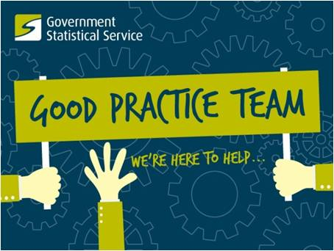



Coordination
Knowledge sharing
Removing barriers
Technical support
Training courses and resources
RAP Champions
Expertise
Mentoring
Review
Share what works
Deep expertise
Best practice
Tools and resources
#rap-collaboration on
govdatascience.slack.com

